Slide 1
T1A3 – Terminal Application
D o n K o u n t o u r I s

Slide 2
Word Game Application
D o n K o u n t o u r I s

Slide 3
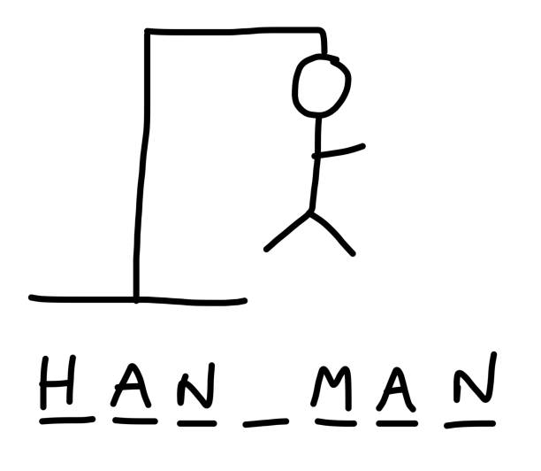
How to play HANGMAN
Hangman is a word game to find missing letters that complete a word.
Blank space represent missing letters.
With the aid of a clue, players begin by guessing a letter.
Correct guesses fill in the blank spaces.
Incorrect guesses lose players lives.
Solve the puzzle before the hangman dies.

Slide 4
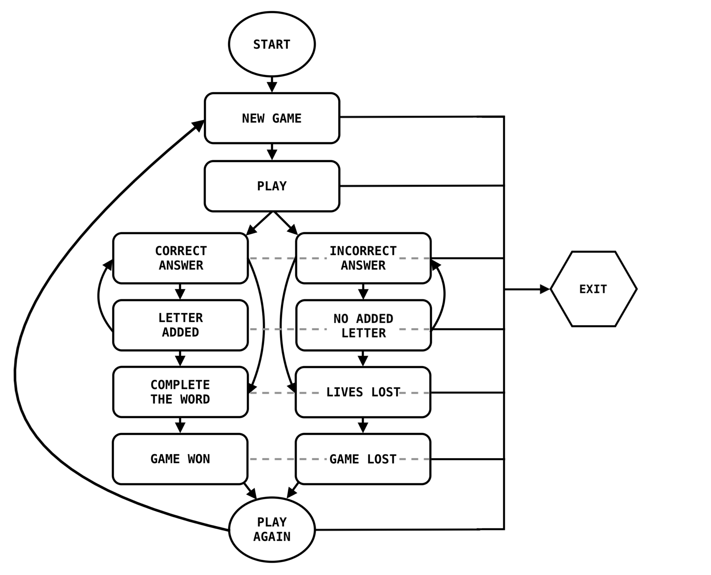
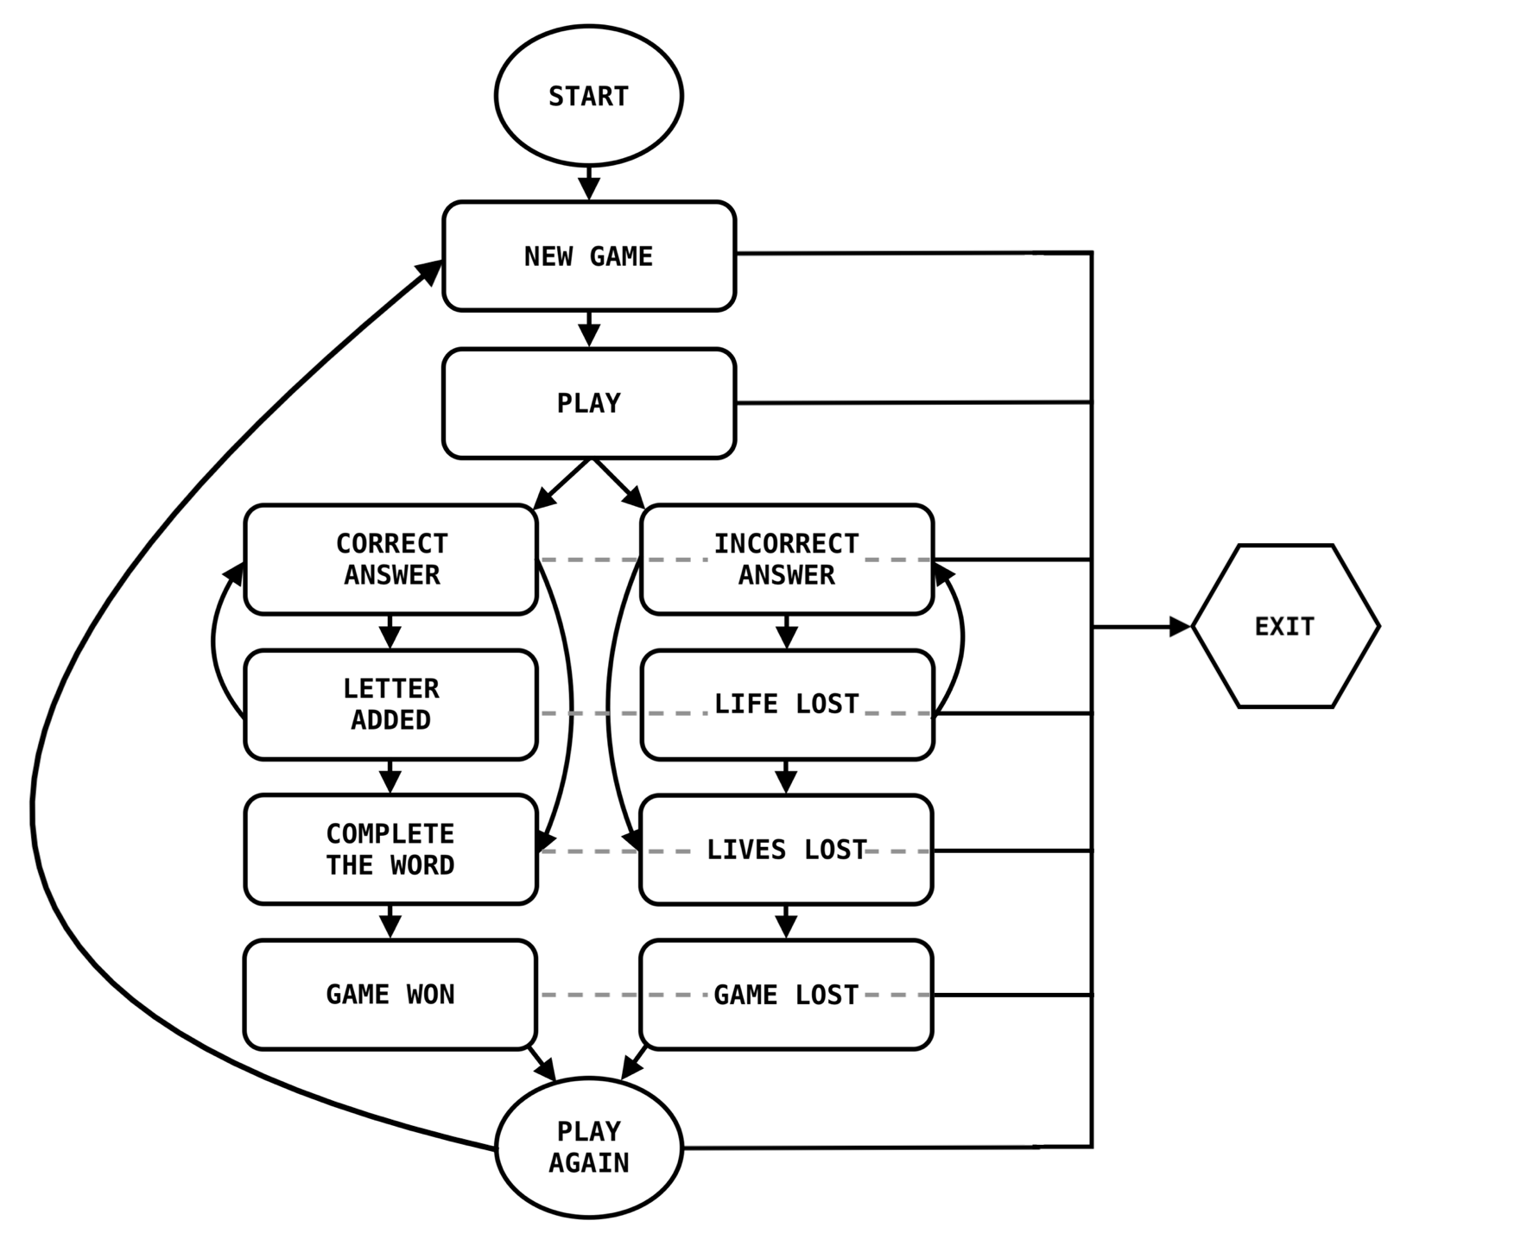

Ready to play
START: Terminal CMD.
NEW GAME: Introduction, Instructions & Clue.
PLAY: Guess a letter.

Slide 5

If you win…
START: Terminal CMD.
NEW GAME: Introduction, Instructions & Clue.
PLAY: Guess a letter.
CORRECT ANS: Adds a letter to the word.
LETTER ADDED: Loops the operation to complete the word.
COMPLETED Loop ends once the word is WORD: completed.
GAME WON: Option to play a new game.
PLAY AGAIN: Loops to the start of a new game and new word.

Slide 6

If you lose…
START: Terminal CMD.
NEW GAME: Introduction, Instructions & Clue.
PLAY: Guess a letter.
INCORRECT ANS: Notifies the error.
NO ADDED Loop the operation to guess
LETTER: again.
LIFE LOST: Incorrect answers result in lose of guesses.
GAME LOST: If guesses run out the game
ends.
PLAY AGAIN: Loops to the start of a new game and new word.

Slide 7
Planning
- Choosing a simple game.
But was it simple…?

Slide 8
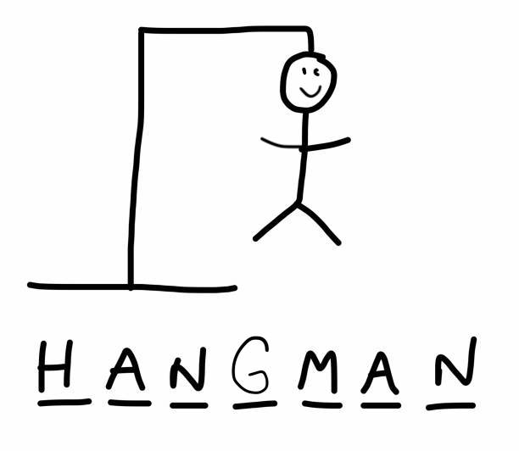
Planning Brainstorming
Simple Functions:
Under scrolls = letters to guess.
Colorize (GEM):
Terminal is black & white – colorizing the text will add some fun and separate the game and its segments from terminal cmds.
Input & Output:
Collecting user input and with that, directing a user’s next steps.
Text to Speech:
Allowing a text to be vocalized throughout the game.
Seems simple enough…

Slide 9
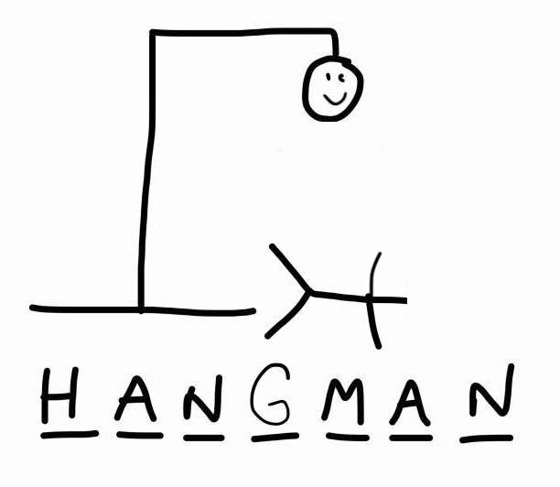
Planning No Brainers
Variables:
As a game there will be many variables.
Conditionals:
Allowing for different outcomes dependent on answers.
Arrays:
Collecting answers to complete the word.
Loops:
Returning to an operation in order to complete the game.
Seems simple enough…

Slide 10






Features
- Game play instructions.
- Hangman game rules.
- Colourised text.
- Game assistance via text.
- Game assistance via speech.
- Exit plan.

Slide 11

Assignment Tasks
- DRY (Don’t Repeat Yourself) code is efficient and minimal.
- Consistent style throughout the code.
- Comments are on each line.
- The two tests to check the app.

Slide 12
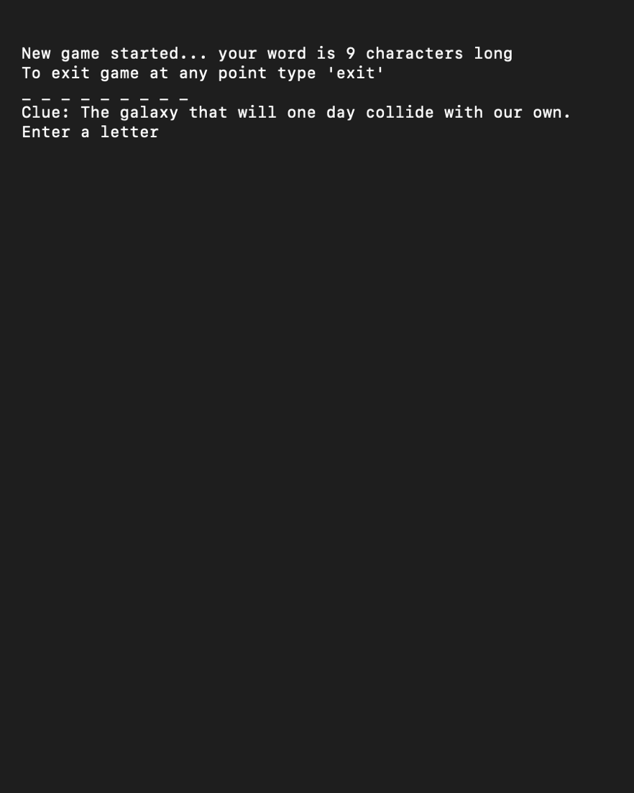
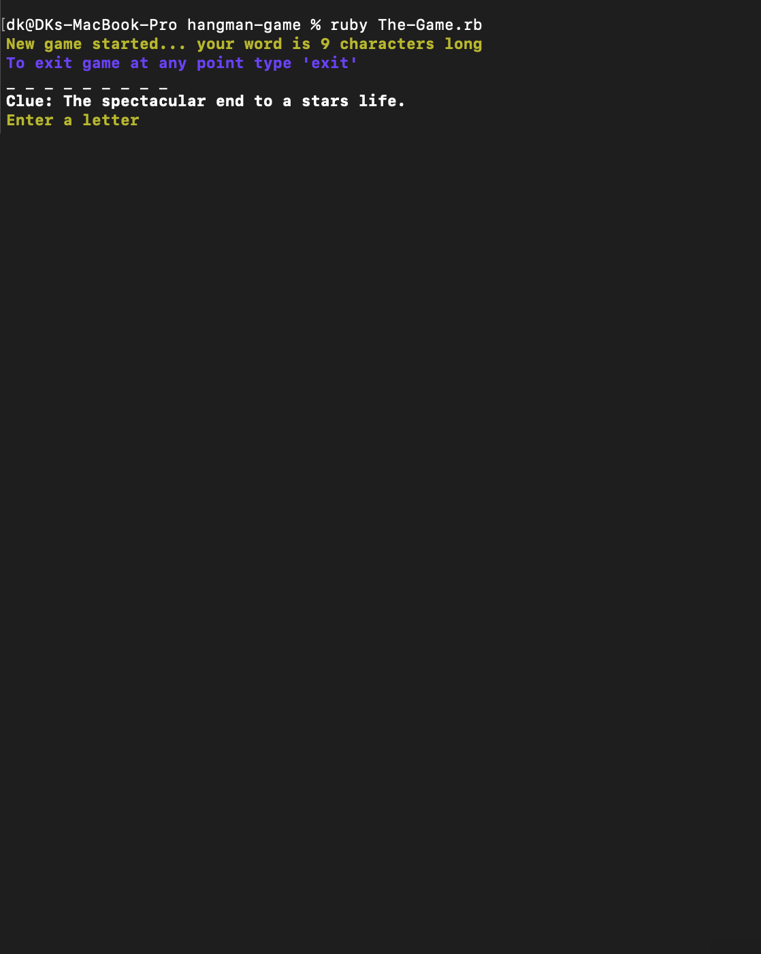
How to play in the terminal:
- Welcome: New game (yellow & bold).
- Character length indication (bold).
- How to exit instructions (blue & bold).
- Empty word ‘ _ _ _ ’.
- Clue phrase (bold).
- Invitation to enter a letter (yellow & bold).

Slide 13
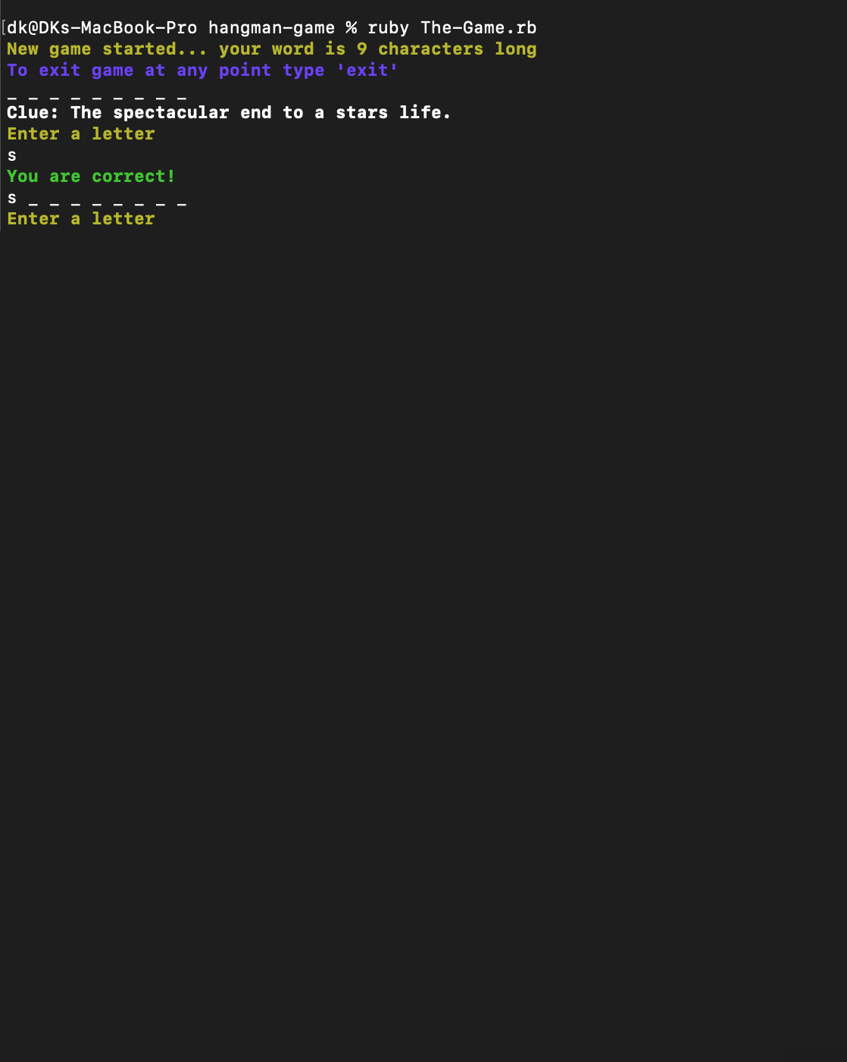
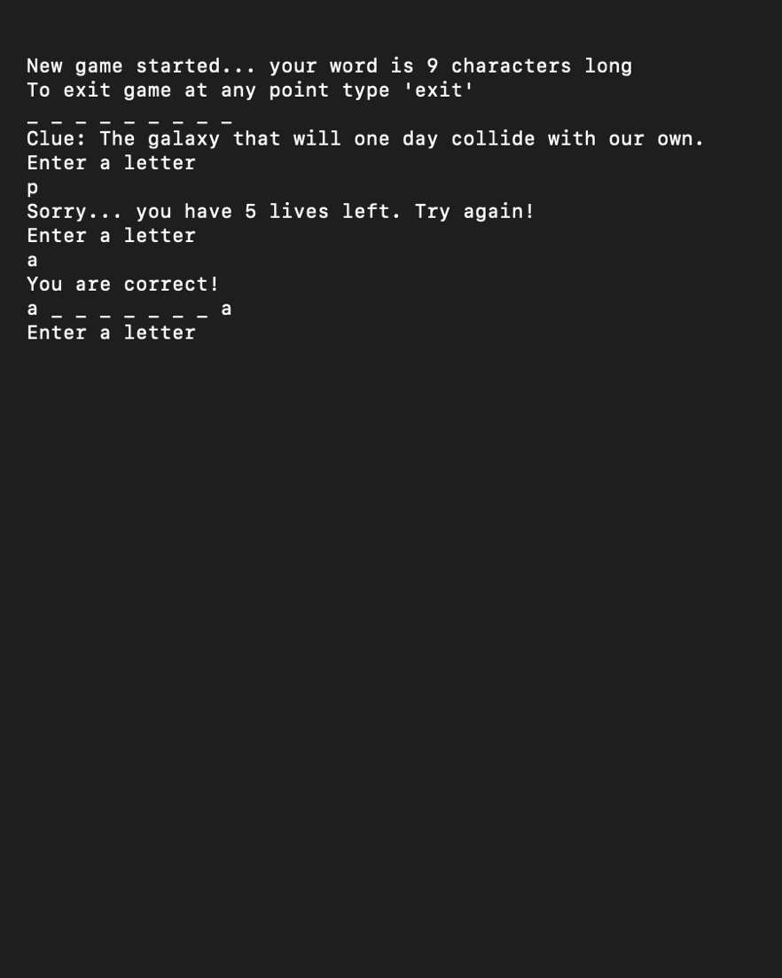
How to play in the terminal:
- Enter a correct letter.
- A correct answer notifies the player (green & bold).
- The correct letter occupies the allocated empty space.
- An opportunity to enter the next letter.

Slide 14
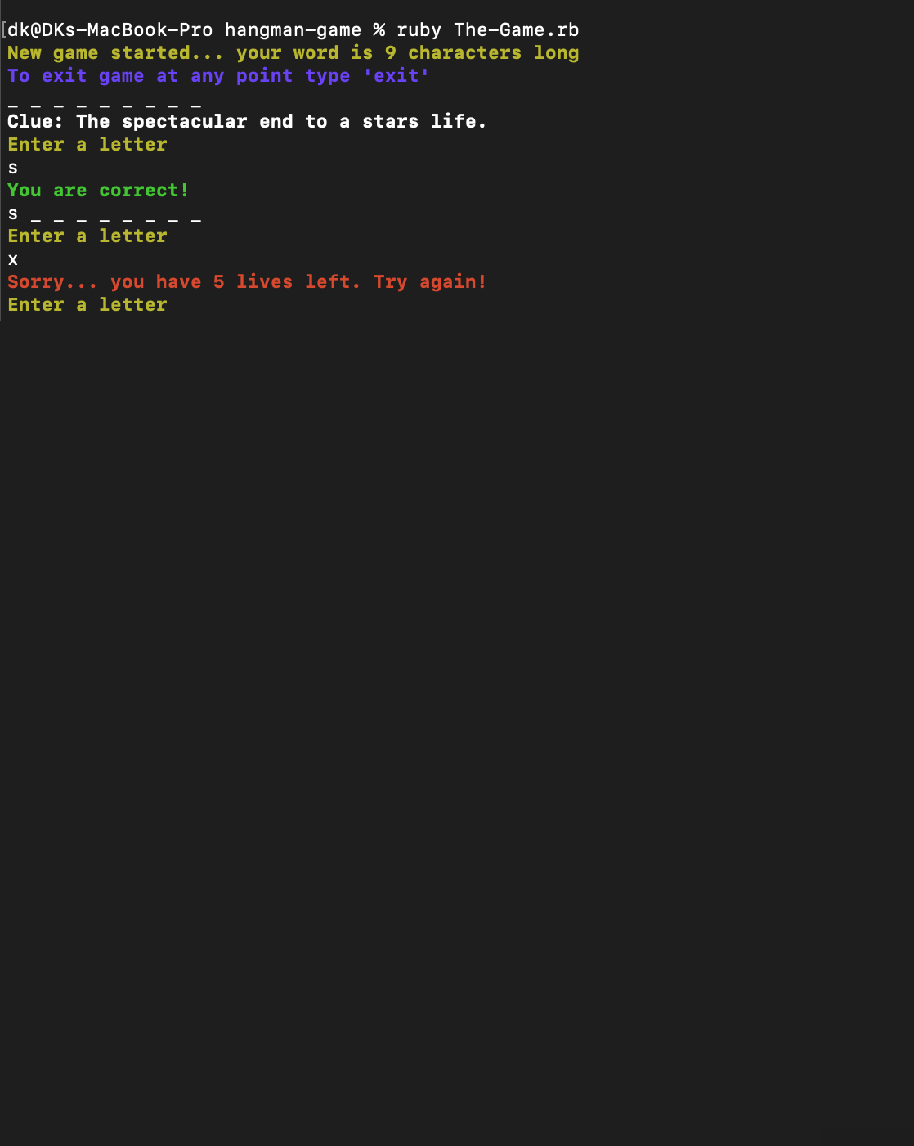
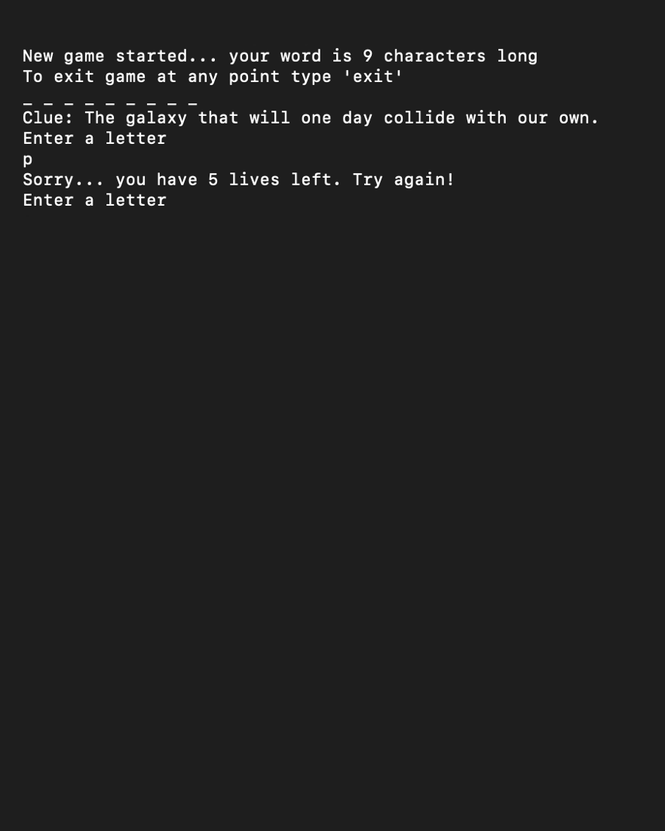
How to play in the terminal:
- Enter another letter.
- An incorrect answer notifies the player, they lose a life (red & bold).
- The user is given an opportunity to try again.

Slide 15
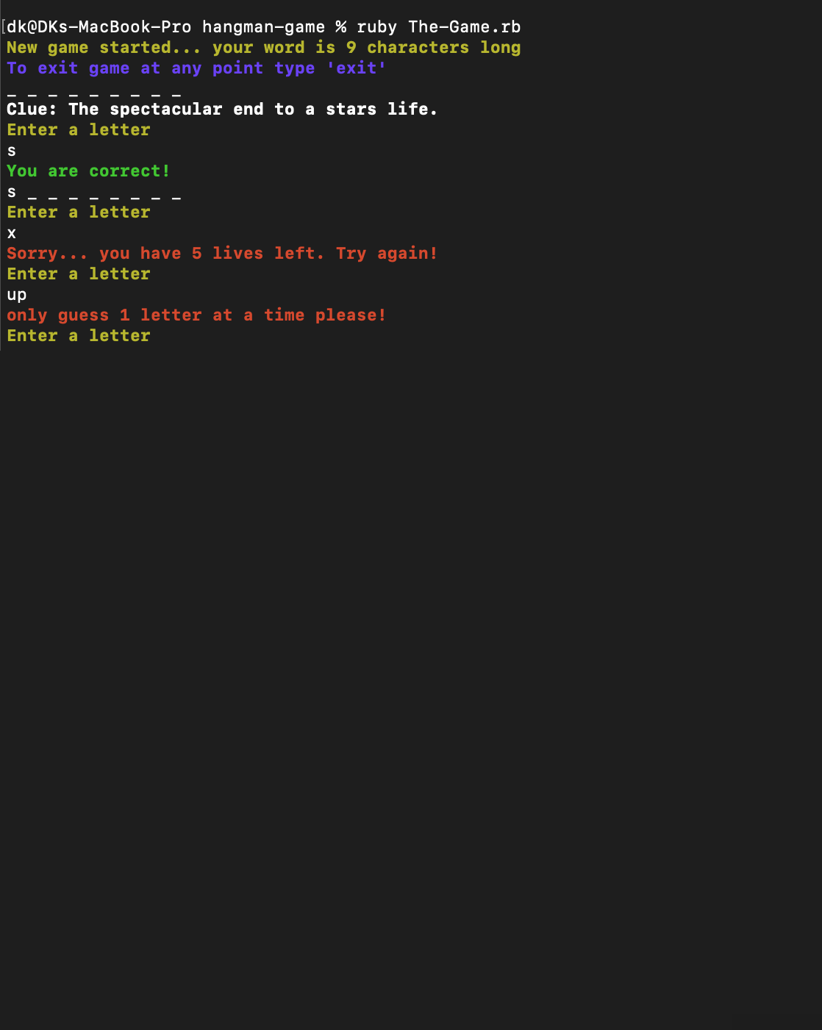
How to play in the terminal:
- Enter two letters at once.
- An incorrect answer notifies the player (red & bold).
- The player does not lose a Life but is told answering with two letters at once is not permitted (red & bold).
- The user is given an opportunity to try again.

Slide 16
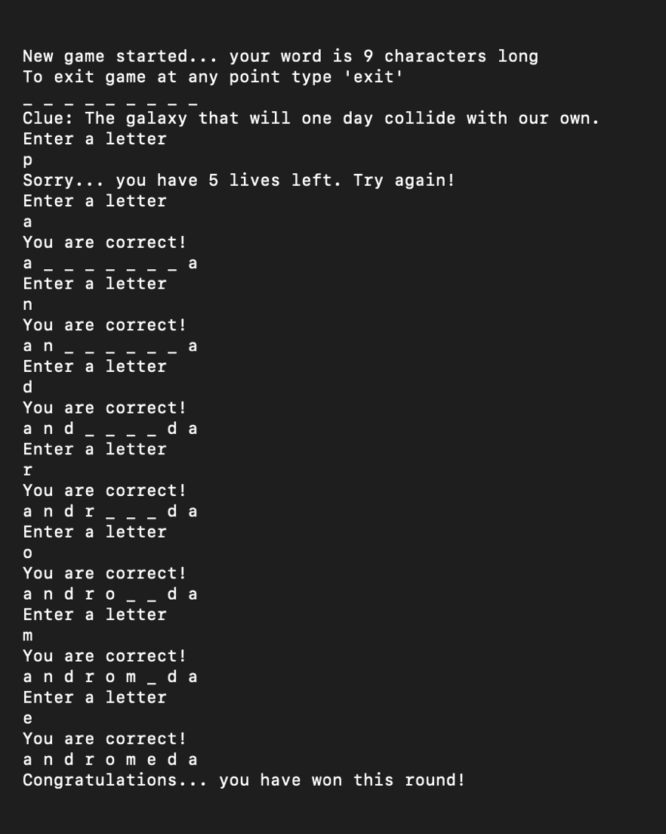
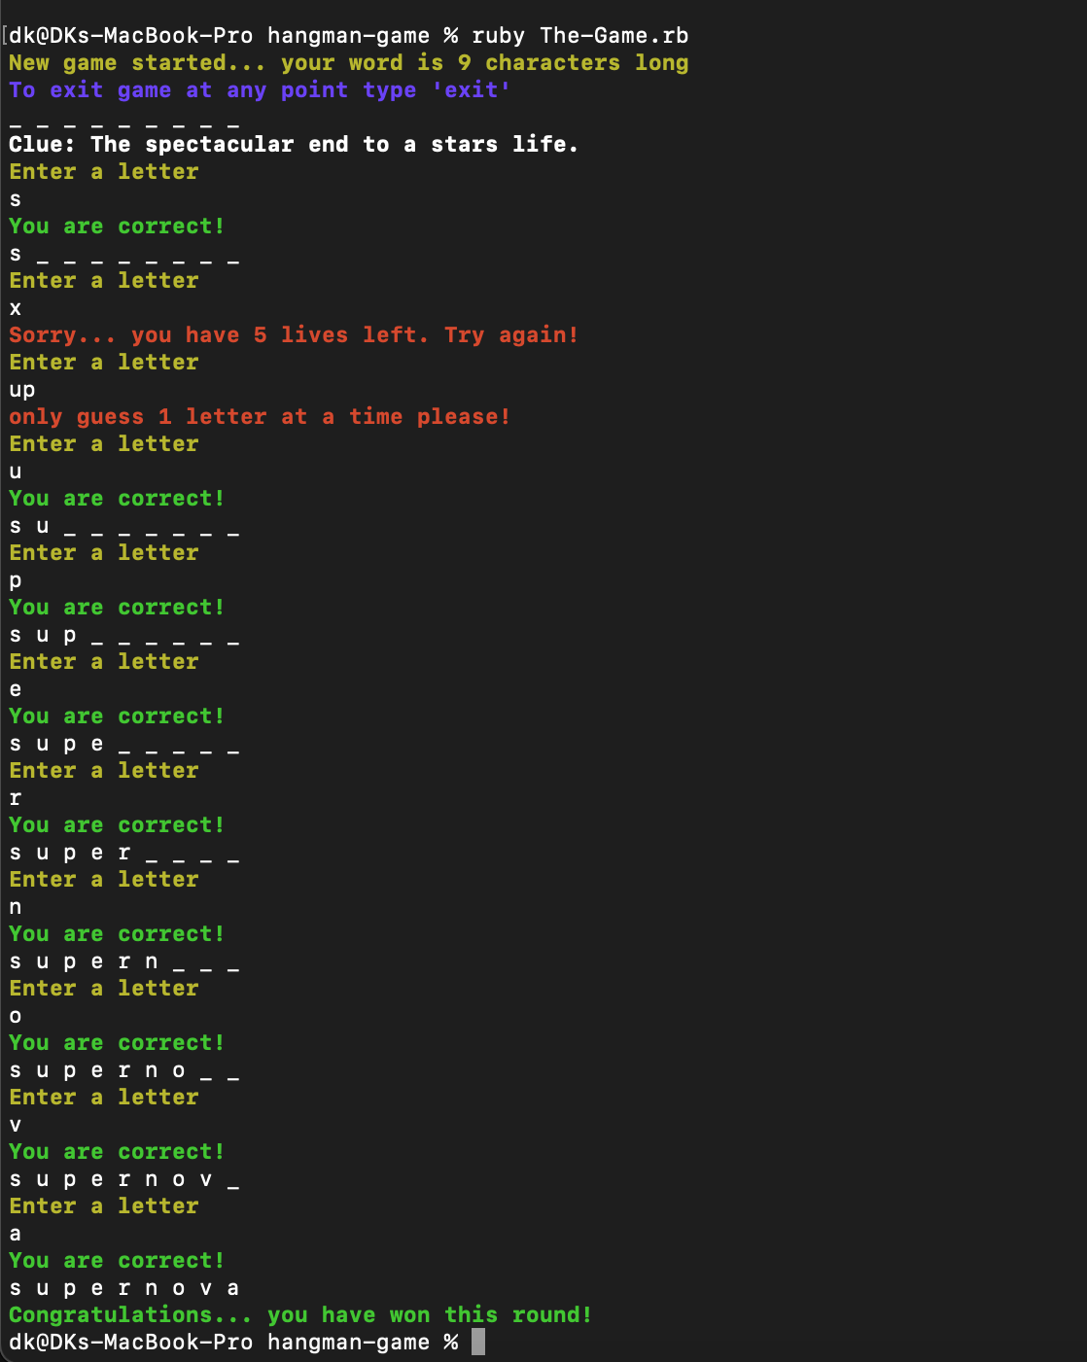
How to play in the terminal:
- Completing the game.
- If all letters are correct, they complete the word.
- Once successful, the player is notified that they have won (green & bold).
- The player can begin a new game with a new word.

Slide 17
Problems
- tts: over complications and possible errors – used an alternative instead.
- Colorize Gem: found difficulty in choosing particular colours.
- Looping the end of game to its beginning rather than exiting out of the app.
- If you hit enter without entering a letter the game responds with a correct answer.
- If you lose the last phrase repeats itself as previous incorrect answers have returned – it states to try again when the game has ended.
- Uppercase letters do not read as lowercase are only considered correct answers.
- Would love to include a picture of hangman correspond to the game.
- When given only 1 life left, the game returns it as a plural.

Slide 18
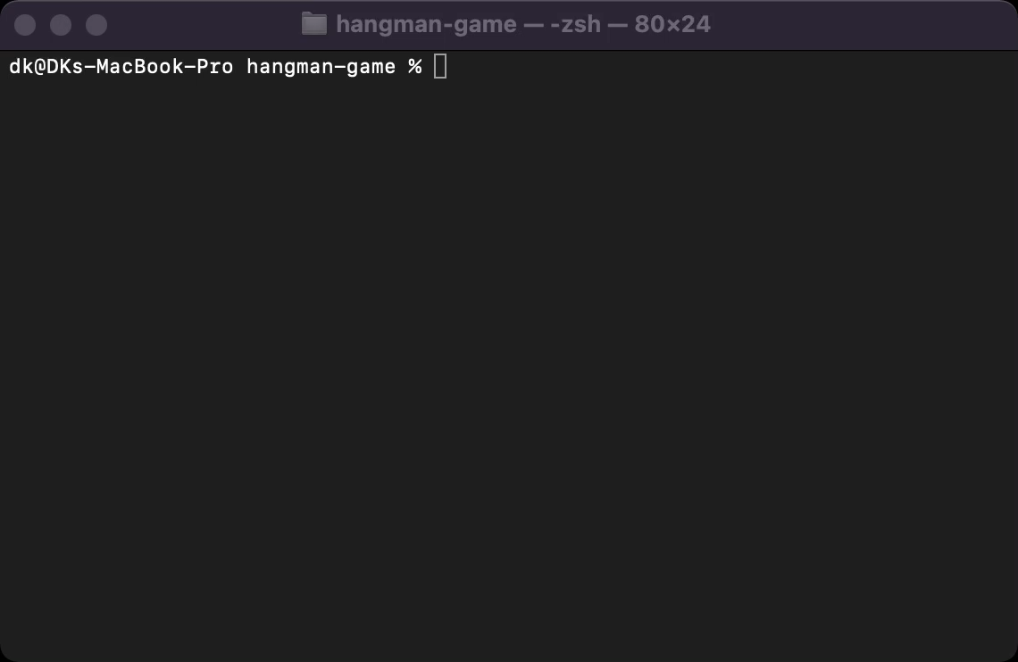
Playing The Game…

Slide 19
T1A3 – Terminal Application
And that’s it!
D o n K o u n t o u r I s

